Slide 1
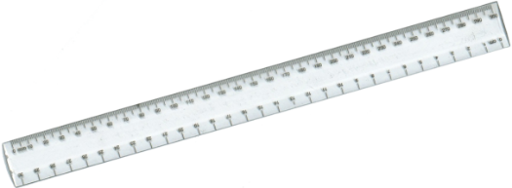
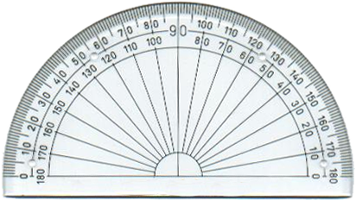
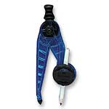

Before you begin make sure you have the following equipment:
A ruler marked in cm and mm
A protractor
A sharp pencil
A pair of compasses

Slide 2
STARTER
A story about Ants…
An army of ants work very hard all day long.
They do everything their boss tells them, all the time.
Every now and then he barks a random order at them just because he can.
If the ants hear the boss’ order, they must obey
The boss’ voice travels exactly 1metre from where he stands
Where are the ants safe to stand to avoid hearing the boss’ voice?

Slide 4
p
d
q

Slide 5
Lets go back to our ants…
The boss is not happy now that the ants have worked out how to avoid doing his orders, so he hires in another boss to help him
He also invests in two Megaphones so both bosses can be heard anywhere
Each ant must follow the orders of whatever boss they are standing closest to.
Now the ants only way of avoiding work is to be exactly the same distance away from each boss
So now where should the ants stand?

Slide 6
And the only option they had was to align themselves in this order

Slide 7
This line represent points equidistant from the two points A and B
A
B
p

Slide 8
Loci
“Loci” is the plural of “Locus”.
A Locus is the path you would follow if you were given certain instructions.
Eg. You must walk so that you are always 5 metres inside the fence surrounding the school fields. Where must you walk?
Eg. A goat is tethered to a rope that is 4 metres long. Show the region the goat can reach.

Slide 9
Loci
There are only FOUR loci.
(1)A fixed distance from a fixed point.
(2)A fixed distance from a fixed line.
(3)The same distance from two fixed points.
(Perpendicular bisector)
The same distance from two fixed lines.
(Angle bisector)
Lets look at the four loci individually

Slide 10
1. A fixed distance from a fixed point
If a point is at a fixed distance from a fixed point, the locus of the point can be illustrated as shown
r
We end up with a circle of radius r

Slide 11
2. A fixed distance from a fixed line
The locus of a points equidistant from a fixed line can be illustrated as below. This can be well represented as below
We end up with parallel lines.
But what about at the ends?

Slide 12
3. The same distance from two fixed points
Step 1 Open a pair of compasses to a distance that is slightly greater than half the distance between the points.
Step 2 From one point draw two arcs, one above the points and one below.
Step 3 Repeat this from the other point.
Step 4 Join where the arcs cross together.

